Slide 2
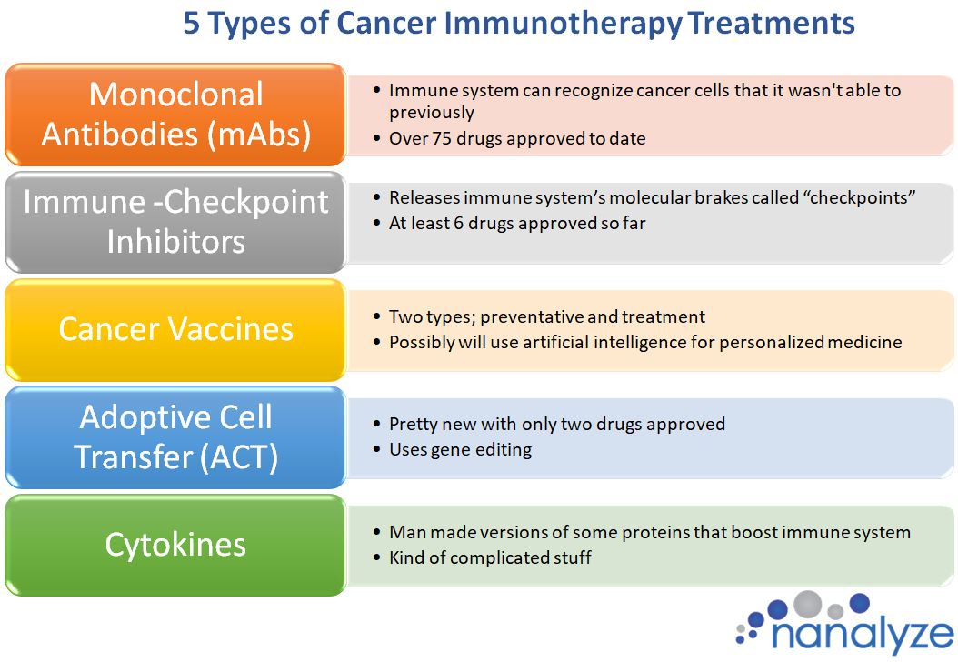
Immunotherapy
Common in early 20th century, until the efficacy of penicillin made it (somewhat) obsolete.
Anti-biotic resistance and rejection of reductionist approach has lead to new found appreciation for the approach.
Especially in cancer treatment.

Slide 3
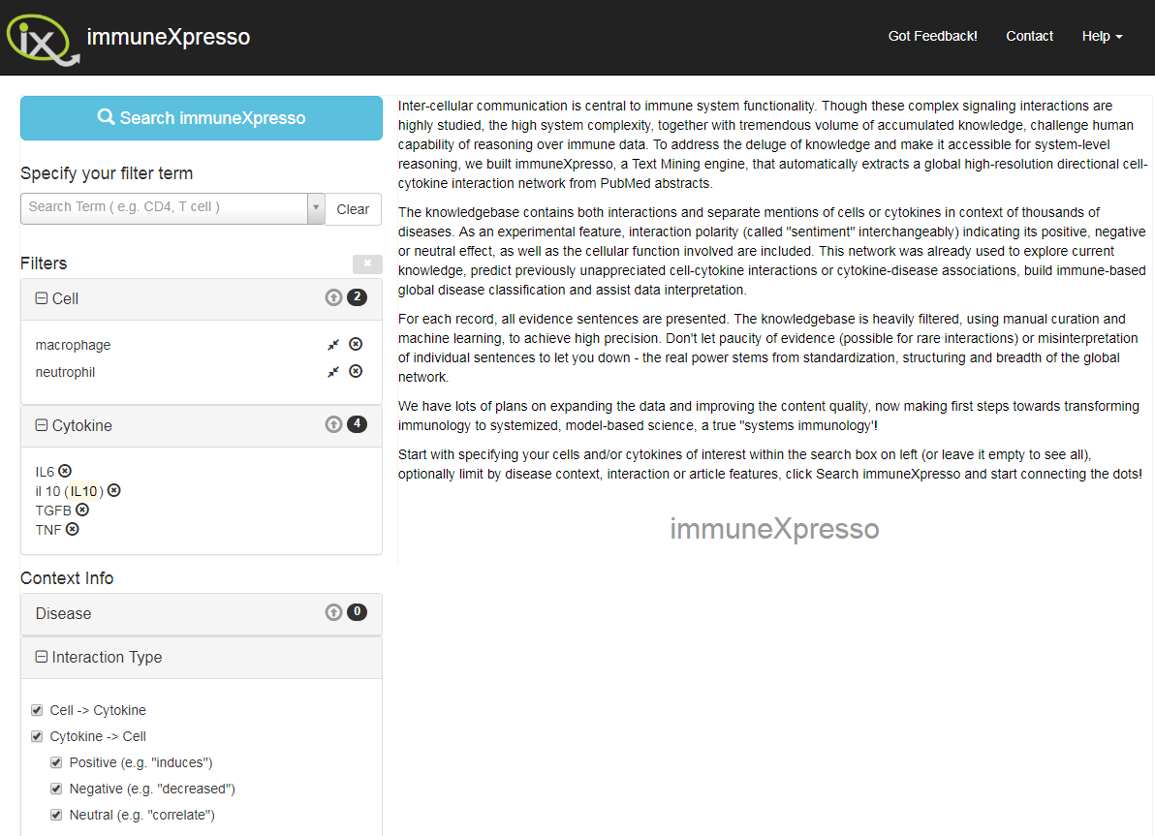
ImmuneXpresso [Kveler et al., 2018]
Prior to finding this paper, we had been manually collating all cell-cytokine interactions from literature.
We can initially train the network on this interaction data but would really like burn wound specific biomarker information over the phases of healing we decide to model.

Slide 4
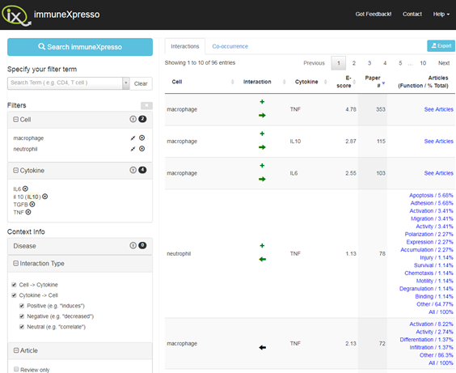
ImmuneXpresso Search Results

Slide 5
Causes of Excessive Scarring
Inflammation phase lasting too long (Tepole,
Macrophages not changing to anti-inflammatory phenotype
Fibroblast overshoot causing collagen dump, can be seen in 1D
Failure to remove inflammatory cells causes pathogenesis of non-healing wounds – but clearing/scrapping wounds may fix this anyway

Slide 6
Proposed Model Structure
HIIS model connected to a generalised ECM by deep learning algorithm.
ECM acts as an interface to ABM models. HIIS can be modulated by AP, while the ECM can be modulated by topical application.

Slide 7
Options for Machine Learning ECM
Simply use a network or Partial DE based on cell-cytokine interactions found in literature
Train a network to be able to translate between the broader categories of the HIIS and the specific ECM composition used by ABM models.
Some combination:
Layers between blood composition and HIIS. Then different neural network connecting these cytokines to the ECM.
Train/establish an interscopic (non-hierachical) network based on cell-cytokine literature and later tuned/refined by data collected at burn centre

Slide 8
Options for ABM models connected to neural network
TU Delft papers – Fred V
Tepole paperas
Create our own hybrid or novel model
Cellular Automata angiogenesis?

Slide 9
Peter goals
What is necessary to adjust the ABM wound healing model to simulate burn wounds? How can we adjust it? Whats the diffence

